Slide 1
LAB - 6 : Programme to compute area & volume
Evaluation of double integral

Slide 2

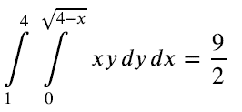
OUTPUT

Slide 3
Evaluation of triple integral

Slide 4


OUTPUT

Slide 5
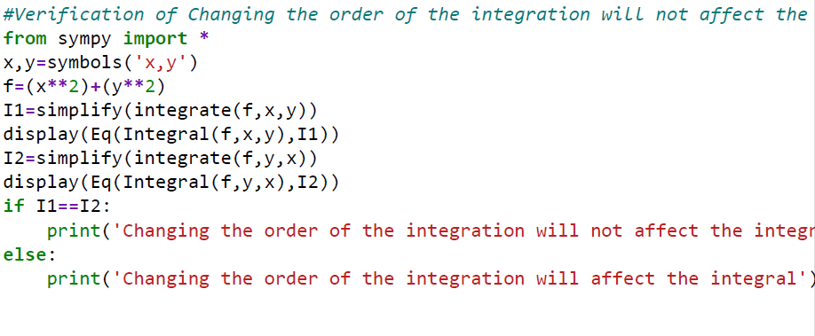

OUTPUT

Slide 6
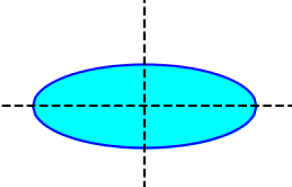
Finding the area using double integral
Finding the area of the ellipse

Slide 7
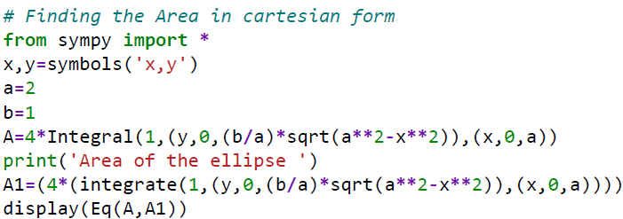
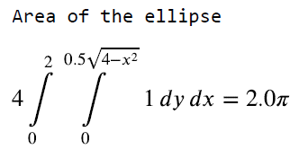
OUTPUT

Slide 8
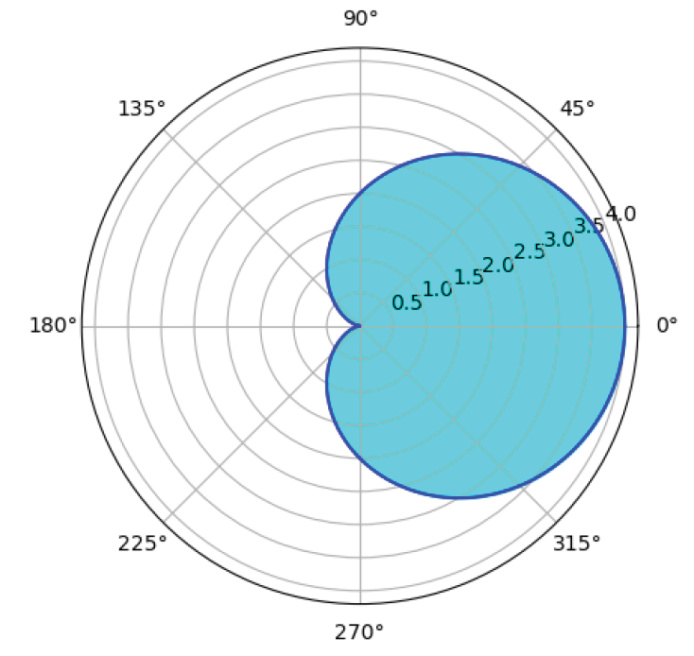
Finding the area using double integral in polar form
Finding the area of the cardioid

Slide 9
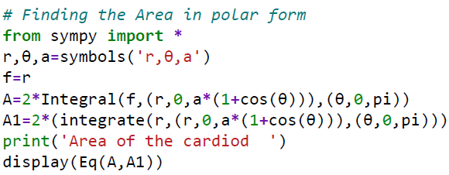
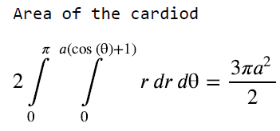
OUTPUT

Slide 10
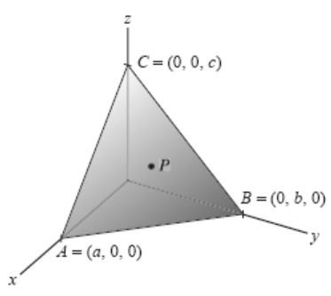
Finding the volume using triple integral
Finding the volume of the tetrahedron

Slide 11

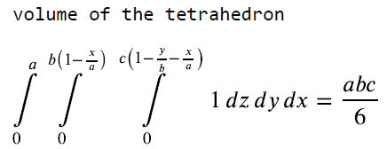
OUTPUT

